Slide 1

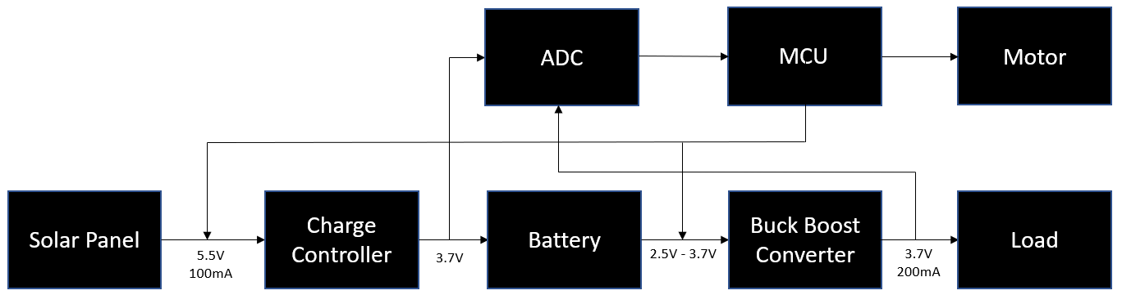
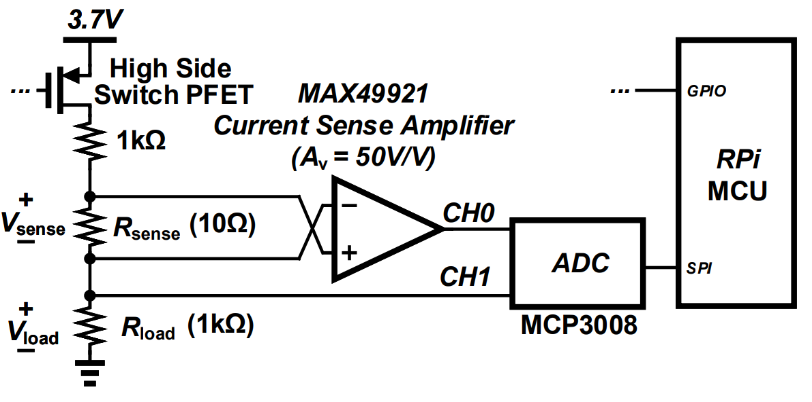
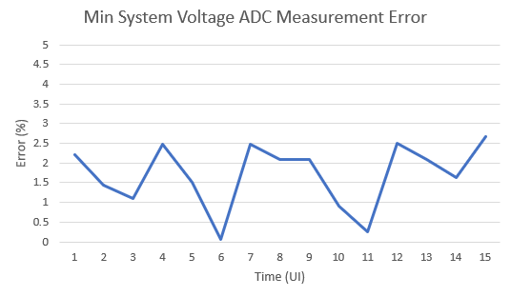
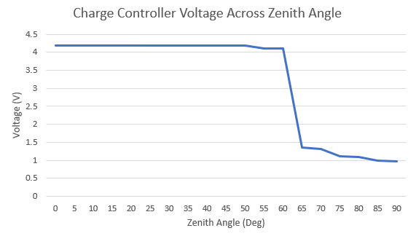
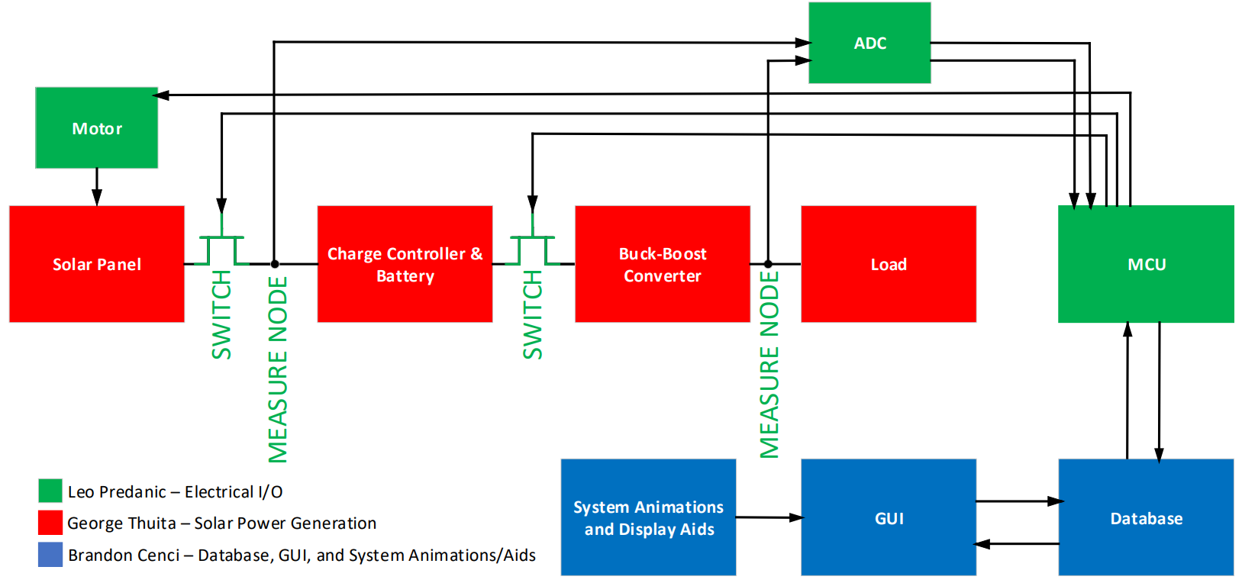
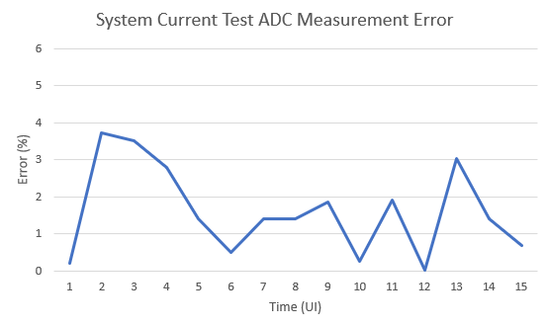
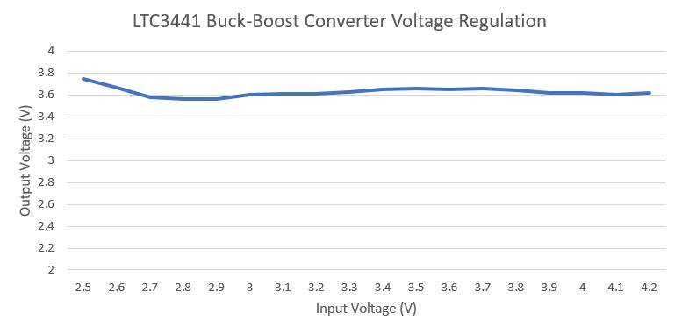
EPS Booth: 309
Creating STEM Contents:
Solar Power with a Tracking System
Leo Predanic, Brandon Cenci, George Thuita
Dr. Wonhyeok Jang, Dr. John Lusher II, P.E.
Problem Definition
As society both electrifies and digitizes, there is an increased demand for engineering solutions. We are creating a small portable solar power demonstration system to help K-12 students get interested in and self-learn STEM topics.
Engineering Analysis
Operation Modes
Charging – In this mode, the unit charges the battery and monitors charge level.
Discharging – In this mode, the unit disconnects the battery, runs power through to the load, and is monitored via electrical sensors.
Fixed Axis – In this mode, the solar panel remains stationary in a neutral position during charging.
Single Axis – In this mode, the solar panel can be rotated to follow the direction of the sun. Manual motor control is used to initialize the position and a time is selected for the rotation cycle.
Design Parameters
Solar Panel and Charge Controller - Regulate the output of a 5.5V 2.5W solar panel to charge a 3.7V Li-ion battery.
Buck-Boost Converter - Input range of 2.5V-4.2V to output ~3.7V at maximum current of 1A.
Battery capacity – 900mAh total capacity with 8-9 hours solar charging and 2.5 hours discharge.
ADC - Measures voltage and current sense amplifier outputs between 0V-5V.
Outcomes
Data Collection
The system is able to collect and store data without issue. While in each of the distinct operating modes, our system is able to successfully track voltage, current, and power for both system sides. The system also successfully updates the internal database with the subsequent data at the correct time stamp.
System Animations
The system is able to display the system animations with the proper pacing without interfering with the operation of the system’s other functions. The animations can be restarted and looped without issue.
Motor Control
The system properly controls the motor, in turn controlling the attached solar panel, with the proper timing. Despite initial issues with staggering during motor operation while operating at the smaller demo durations, the system has since improved its method of motor control timing to resolve any pacing issues.
Figure 5. System Electrical interface
Methodology
The system is comprised of three subsystems.
Solar Power Generation:
Generate electrical power from solar radiation and store in a battery.
Regulate stored energy and power various loads.
Electrical I/O:
Measure voltage, current, and power at various nodes for display.
Control system operation through disconnect switches and solar panel rotation via a motor.
GUI, Database, and Animations:
Store collected data in a database to display in a GUI
GUI features displays, controls, and animations
Figure 6. Power Sensing Schematic
Impact
By creating a small-scale, simplified solar panel tracker that can be replicated by K-12 students, this project is able to:
Inspire Curiosity : Through hands-on interaction, the system inspires students to create their own projects
Foster Creativity: By showcasing the possibilities of simple components, the system creates opportunity for students to learn problem solving
Provide Engineering Experience: Expose technical knowledge on the operation of a basic solar power system.
References
‘How many degrees are earned in engineering, and what subfields are the most popular?’, National Science Board.
https://www.nsf.gov/nsb/sei/edTool/data/engineering-01.html
Electrical Rechargeable Battery Standards:
https://www.epectec.com/batteries/battery-standards.html
Solar-Power-Standards: https://webstore.ansi.org/industry/solar-energy
Figure 4. Minimum System Voltage Output Sensing Error
Figure 2. Charge Controller Voltage Across Zenith Angle
Acknowledgements
Thank you to both Drs. Jang and Lusher for assisting us with system design, debugging, and technical help throughout the year.
Figure 1. System Block Diagram
Figure 3. Buck-Boost Converter Output vs. Input Voltage.
Figure 5. Maximum System Current Output Sensing Error

